Slide 1
Bicycle Hire Planner
“It’s Not a Bug It’s a feature” Client Meeting Two

Slide 2
User Stories and Epics Update

Slide 3


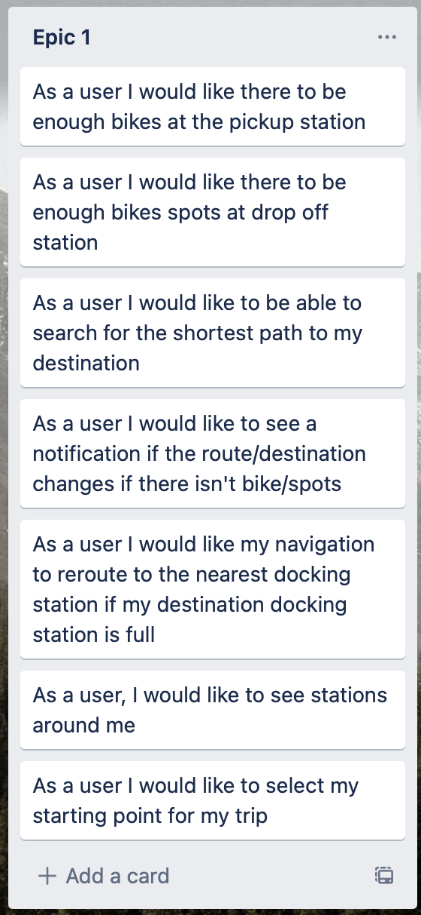
Epic one Remainder
Rerouting user if their destination dock is full

Slide 4
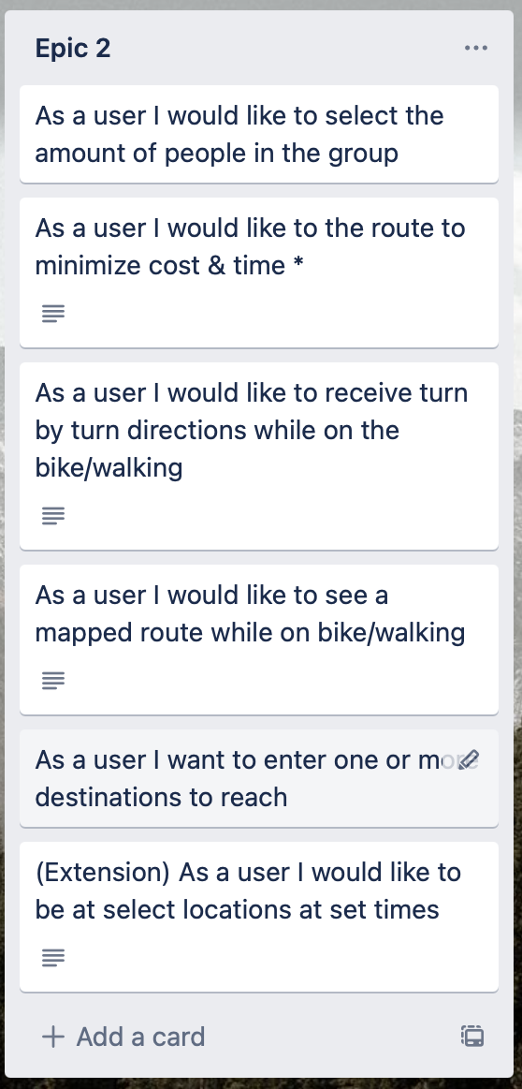
Epic Two Remainder
Minimize Cost Route
Extension for Set Times Moved to Epic Three

Slide 5
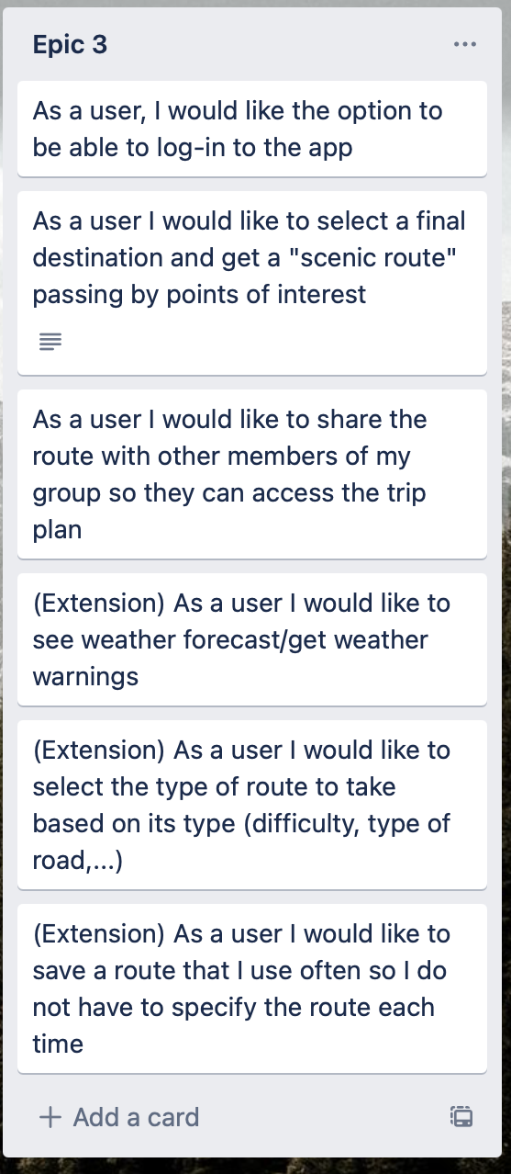
Epic Three
Login has been Implemented
Firebase has been Setup & Connected

Slide 6
User Interface Update

Slide 7
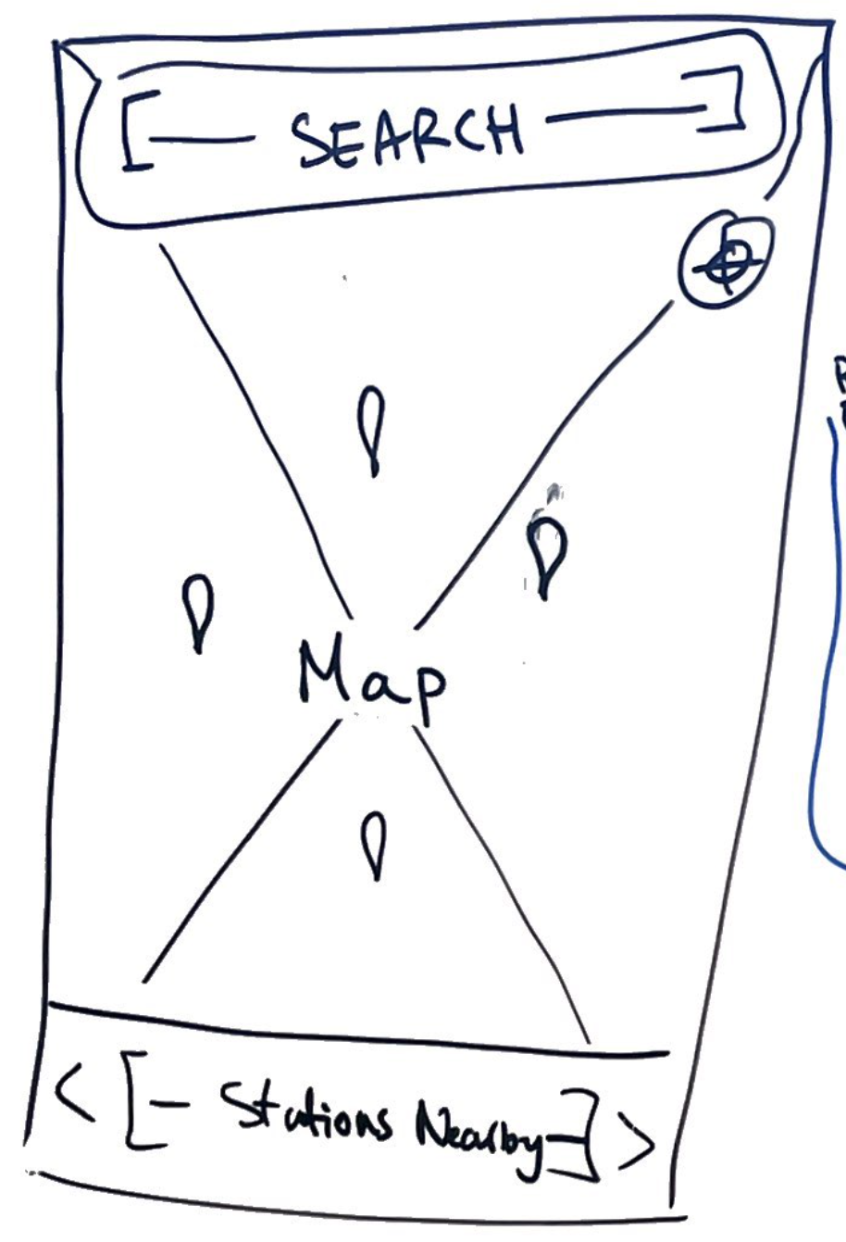
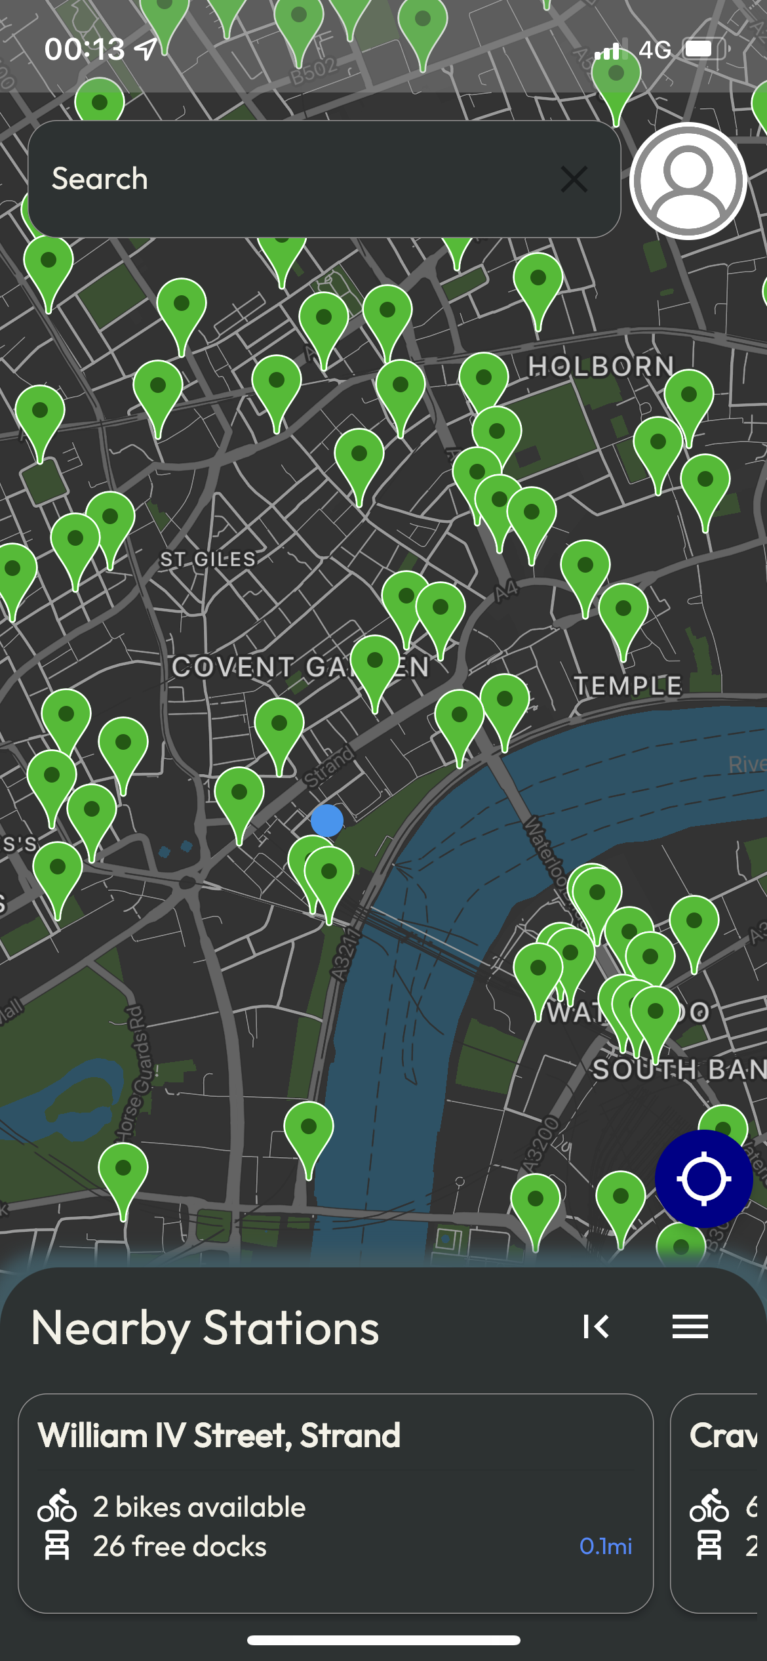
Home Page

Slide 8
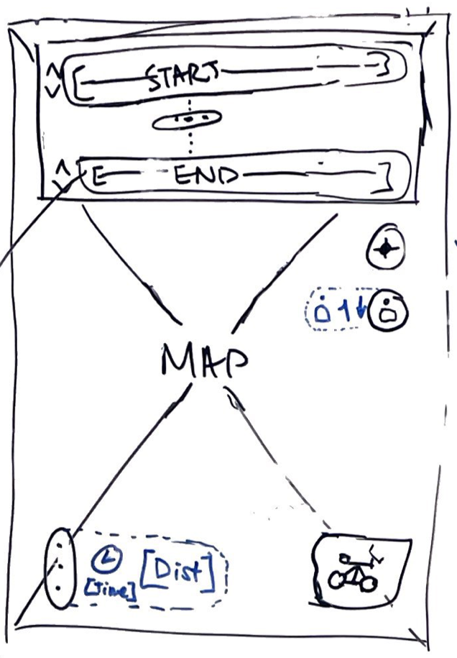
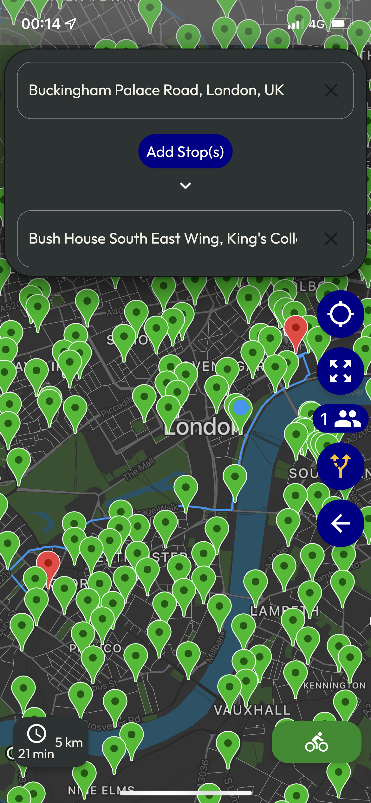
Route Planning

Slide 9
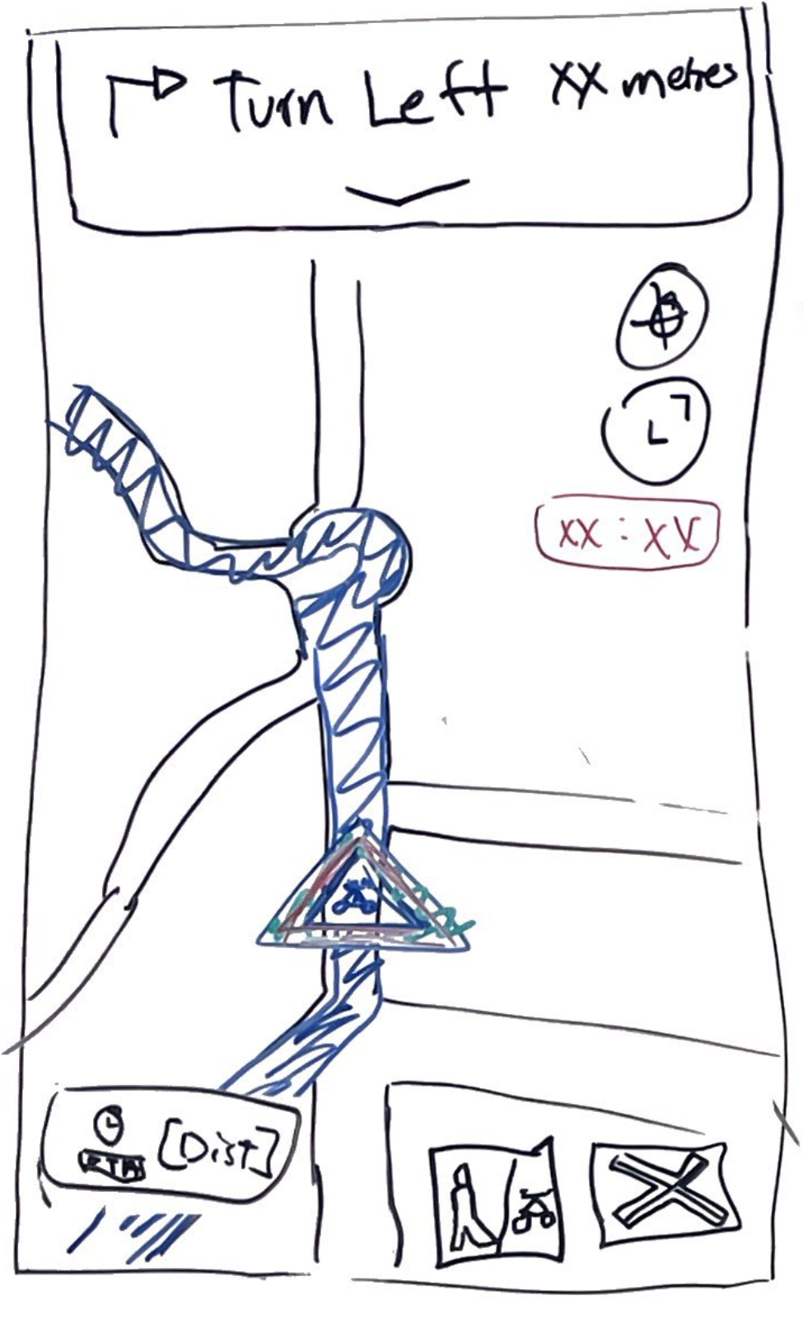
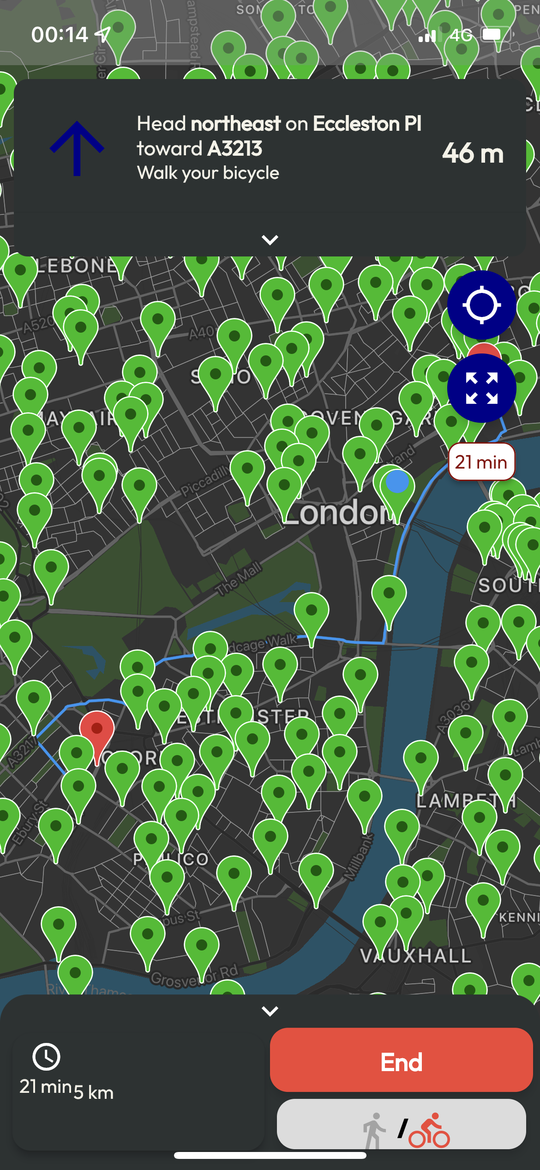
Navigation

Slide 10
App Video Tour & Client Hands-On
Any Input or Suggested Changes

Slide 11
Project Timeline
Week March 1st – March 8th
Finalize Epic One & Two
Stabilization/Bug Fixes
Performance Improvements
Minor Refactoring
Week March 8th – March 15th
Research Process for Deployment
Ease of Use Extensions
Setup Logged in Extensions
Week March 15th – March 22nd
Start Project Report
Logged in Extension
Week March 22nd – April 1st
Final Bug Fixes/Tweaks
Finalize Deployment
Finalize Report

Slide 12
Clarifications
Navigation when Not at Start Location

